Slide 1

2024-2025 AGM MEETING

Slide 2
Team presentation
Junior team (Coach Dom)
Open team (Coach Al)
Intermediate team (Coach Brad)

Slide 3


Supper

Slide 4
WELCOME TO THE 2025 AGM

Slide 5
Welcome
A sincere Thank you to all the players and parents for a successful season.
  Agenda for the AGM
    Financial report
    Executive reports
    Amendments to our Constitution
    Elections

Slide 6
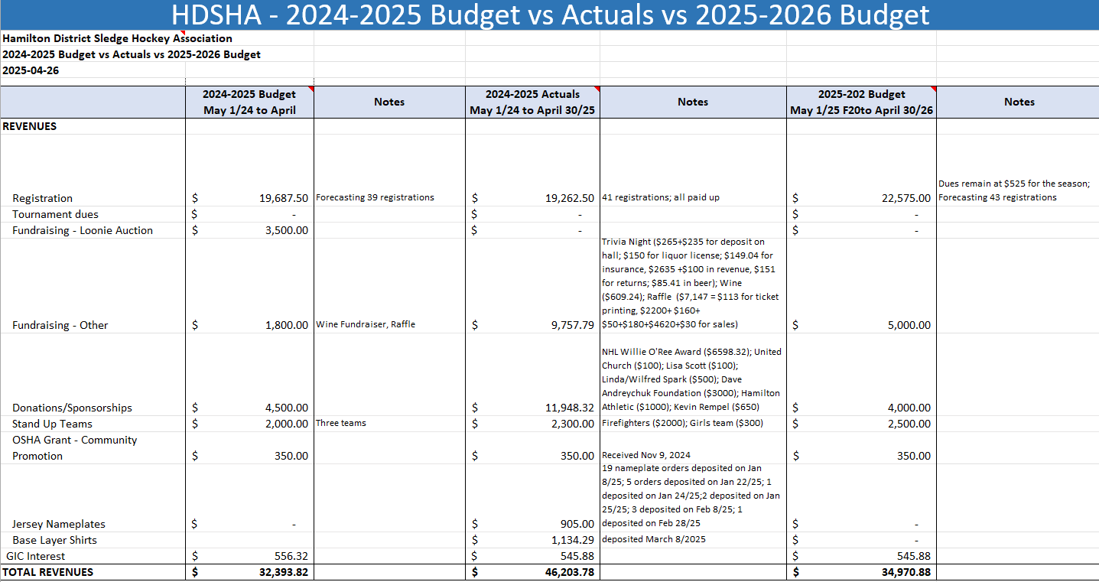
Financial report – Marcel Kampen

Slide 7
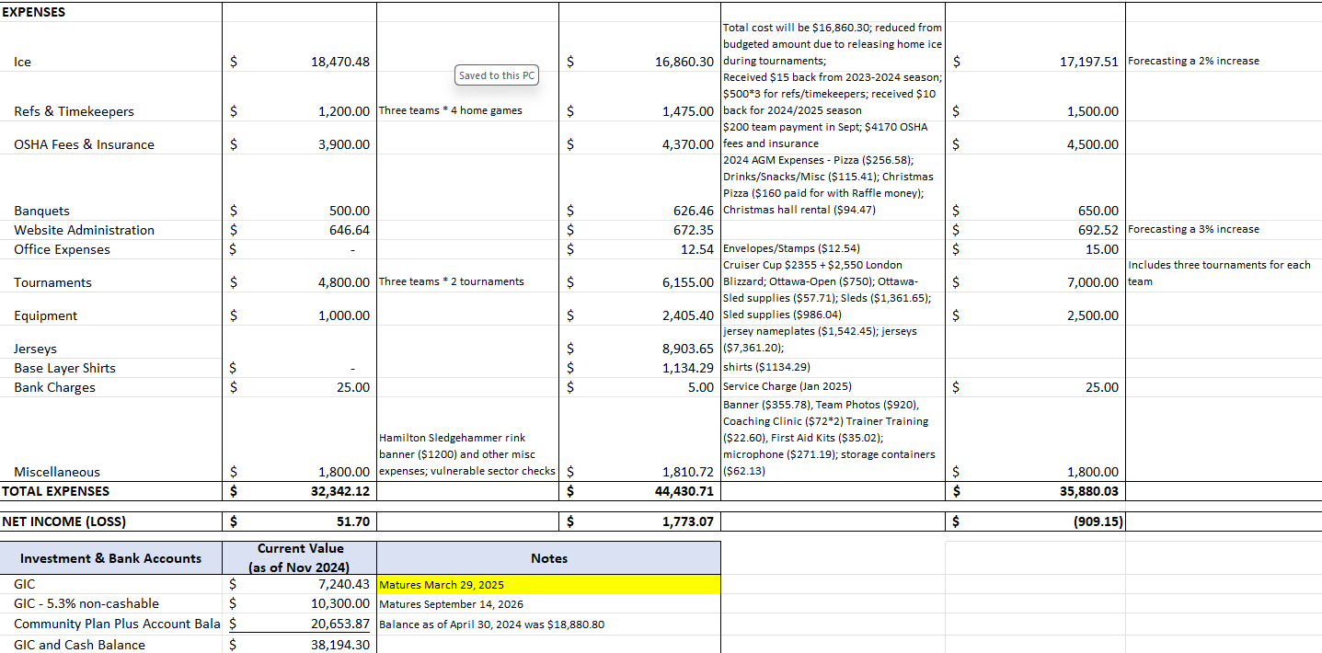
Financial report – Marcel Kampen

Slide 8
HDSHA President – Mike Séguin
Re-cap on season:
  Great showing by all three teams.
  All teams participated in three tournaments this year. Again, a great showing from all three teams in these tournaments.
  The Executive Committee would like to say a Thank you to all the coaches, managers, trainers, pushers…for your help with the players during the season.

Slide 9
HDSHA President – Mike Séguin
Next season for our Association:
  Waiting on the City to confirm our Ice for next season but should remain the same.
  We are hoping to have players commitments as soon as possible since we need to confirm by August 1st our number of teams participating in OSHA next season.
  We are expecting to have more new players next season in all teams. We want to see a continuing growth with our numbers and maybe add a 4th team!
  We are always looking for volunteers for coach, trainer, managers, pushers and to help with fundraisers. All help is greatly appreciated.

Slide 10
HDSHA President – Mike Séguin
OSHA news:
  Those who submitted a new VSC last year, only need to complete the declaration the next two years; all new trainers, coaches…will need to get a VSC this summer.
  AP players: All players moving up to AP will need to fill out a form at the start of the season.
  (Reminder) Coach certification: All coaches need the Community Sport Coach 1 – Intro to Coach.
  (Reminder) Trainers: All teams need one certified trainer on the bench.
  OSHA has a couple of positions opened (STO manager and ParaSport Coordinator)
  Strategic Planning Committee for OSHA to plan the next 4 years for OSHA.
  Hamilton has two board members with OSHA. Congrats to Al (VP) and to Steve (Director at large).

Slide 11
Executive reports
  Claire Collison (VP)
  Steve Jennings (Hockey Operations)
  Marcel Kampen (Treasurer)
  Allen Hierlihy (PR)
  Denise Hierlihy (Fundraising)
  Brad Fairman (Registrar)
  Dominik Roos (Volunteer Coordinator)

Slide 12
HDSHA Constitutional Amendments
We will go through the Constitution and the changes proposed by the Executive.
We will vote after every article.

Slide 13
HDSHA Constitutional Amendments
ARTICLE I
NAME
HAMILTON AND DISTRICT SLEDGE HOCKEY ASSOCIATION (HDSHA)
Hamilton Para Ice Hockey Association (HPIHA)
i. The name of this club shall be HAMILTON AND DISTRICT SLEDGE HOCKEY ASSOCIATION (HDSHA) Hamilton Para Ice Hockey Association (HPIHA).
All in favor? Opposed?

Slide 14
HDSHA Constitutional Amendments
ARTICLE II
PURPOSE OF HDSHA (HPIHA)
The purpose of the club is to provide both recreational and competitive Sledge Hockey Para Ice Hockey Programs in a safe and positive environment.
All in favor? Opposed?
ARTICLE III
MEMBERSHIP
Membership is limited to Executive members, coaches, managers, trainers, volunteers and HDSHA HPIHA PLAYERS or their Legal Guardian who are fully registered to play sledge para ice hockey and/ if registration fees are paid and up to date.
All in favor? Opposed?

Slide 15
HDSHA Constitutional Amendments
ARTICLE IV
THE EXECUTIVE SHALL CONSIST OF:
PRESIDENT
VICE-PRESIDENT
TREASURER
ADMINISTRATIVE ASSISTANT
FUNDRAISING CHAIRPERSON
VOLUNTEER CHAIRPERSON
PUBLIC RELATIONS CHAIRPERSON
REGISTRATION CHAIRPERSON REGISTRAR
HOCKEY OPERATIONS CHAIRPERSON
  The term of office for any person elected to the HDSHA Executive shall be two years with positions staggered to maintain continuity.
  Should any member of the executive resign before the end of the two-year term, a replacement executive member will be chosen by majority vote by the remaining members of the executive. a vote should be made in the following two weeks for all positions except for the President, Vice-President and Hockey Operations (see Article 9, section 3).
  All in favor? Opposed?

Slide 16
HDSHA Constitutional Amendments
ARTICLE V
MISSION STATEMENT
To foster, promote and teach the game of sledge para ice hockey, to provide a sport/recreation opportunity to disabled individuals. in our catchment area defined by OSHA.
To develop and encourage sportsmanship, community spirit and playing ability by offering a level of opportunities in sledge para ice hockey from development, recreational and competitive.
To develop and build self-esteem and confidence among participants through social interaction and participation.
To promote the sport of sledge para ice hockey within the community to raise awareness and participation in sledge para ice hockey.
To sponsor and promote athletic, social and other activities for the betterment and growth of the association.
All in favor? Opposed?

Slide 17
Article 6
Section 2. Vice President
Assume the duties of the president in his/her absence.
Perform any duties delegated by the president.
Attend all Sub Committee meetings as required.
Be one of Three Signing Officers of the Association.
Shall be responsible for Scheduling for the Association.
Record and keep accurate minutes of all meetings and distribute them in a timely manner.

Slide 18
Section 4. Treasurer
Handle funds and finances for club.
Keep financial records.
iii. Pay bills and release funds as voted by the general membership.
iv. Make financial reports at least once a month at the meeting.
Develop and an annual budget for the HDSHA HPIHA Executive to Review and Approve.
Shall Hand over all Financial Property of the HDSHA HPIHA President upon resignation.
Shall CO-ORDINATE the Investment of HDSHA HPIHA funds based on the directives of the HDSHA Executive.
viii. Be one of Three Signing Officers of the Association

Slide 19
Section 6 Public Relations Coordinator
Shall be primarily responsible for public relations and communications/ advertising for the HPIHA HDSHA.
Shall periodically produce a newsletter and/or maintain the HPIHA HDSHA website with up-to-date content/events and information that may be relevant to our membership.
Shall provide expertise and assistance to other committee members in order to maximize media and news coverage for all member activities.

Slide 20
Section 7 Registration Coordinator Registrar
Shall compile and distribute Pre-Registration packages for the previous year’s players.
Shall Co-ordinate all necessary steps with respect to registration dates. Two dates or more will be set aside for the registration of new players, Advance notice of these registration dates will be communicated in co-ordination with the Public Relations Chairperson.
Shall ensure that registration documents for all players are complete and on file in the HCR database prior to any player participating in on-ice activities.
Shall co-ordinate with Hockey Operations to ensure hockey sweaters/pants and association provided equipment is available.
Shall assist Hockey Operations with Coordination of Uniforms and distribution of same to Team Managers prior to season start.
vi. Shall keep any relevant participant data such as medical issues that team managers/coaches and trainers should be aware of.
Shall explore all avenues of potential volunteer recruitment.
Shall work with the executive regarding the development of a volunteer application forms and a formalized screening process.
Shall keep a complete and regularly updated record of all volunteers. This will include phone numbers and addresses. (HCR)
Shall assist student volunteers with logging of hours and tasks for School requirements.
All in favor? Opposed?

Slide 21
ARTICLE VII
ELECTION OF OFFICERS
Elections will be held every two years at the AGM WHICH IS CONDUCTED in the month of May. On the even year, the elections shall be for the positions of President, Treasurer, Administrative Assistant and Fundraising Coordinator. On the odd year, elections shall be for the positions of Vice President, Volunteer Coordinator, Public Relations Coordinator, Registration Coordinator Registrar and Hockey Operations Coordinator.
All in favor? Opposed?

Slide 22
ARTICLE X
FINANCIAL RESPONSIBILITY
i. The Treasurer in conjunction with the executive will prepare and present a yearly operating budget for the Fiscal Period from (May 1st) June 1, xxxx to (April 30th) May 31st , xxxx that must be approved by the executive and reflected in the minutes. ii. HPIHA HDSHA funds shall be used for the purpose of providing Sledge Hockey to registrants and meeting the mandate described in ARTICLE II and ARTICLE V
A financial statement, including an original bank statement, must be presented at each executive meeting providing updates on debits/credits for the period.
Signing authority for HPIHA HDSHA accounts shall be the President, Vice President, Treasurer. At least two signatures must be present on all HPIHA HDSHA cheques issued.
All HPIHA HDSHA accounts shall be held in a recognized financial institution in the Province of Ontario.
The executive can designate funds to be held in bonds or GIC’s that do not threaten capital and that have been approved by the executive. vii. The HPIHA HDSHA can maintain a positive bank account balance equal to two years’ one-year operating expenses based on the previous years’ budget to cover shortfalls and exceptional circumstances regarding operations.
Upon application and approval by the Executive, the HPIHA HDSHA may support financially challenged individuals who have exhausted previous funding alternatives.
Should the HPIHA HDSHA cease operations and fold as an association, excess funds shall be distributed firstly to outstanding Invoices and obligations and secondly to a charitable association supporting disabled sports.
All in favor? Opposed?

Slide 23
ARTICLE XI
SOURCE OF FUNDS
The principal source of funds for the HPIHA HDSHA will be registration fees charge to participants.
Registration fees can be increased annually but not exceeding 5% each year.
Fundraising, Grants, Corporate and all other donations will be accepted and directed first as wished by donor, then to operations as deemed necessary by executive.
Fees may be charged for tournaments at the discretion of the HPIHA HDSHA executive.
All in favor? Opposed?

Slide 24
ARTICLE XII
FISCAL PERIOD
i. The fiscal period of the HPIHA HDSHA will be from May June 1, xxxx to April
30th May 31, xxxx
ii. All financial activity for the period shall be presented in a year-end account statement prepared by the treasurer.
All in favor? Opposed?

Slide 25
ARTICLE XIII
EXECUTIVE MEETINGS
Executive Meetings should be held once per month or at the discretion of the executive Committee. ii.
Each Executive Member will have a single vote. The president will only vote in the event of a tie.
Each executive member must vote unless there is a conflict of interest.
iv. A Quorum is declared for executive meeting at 5 4 executive members present.
Any motion voted on must be carried/denied by a majority vote.
Decisions made by the executive shall be reflected in the minutes.
Minutes from each meeting to be completed in a timely manner and distributed to the executive.
Minutes from executive meetings are confidential and are only distributed to executive members.
Guests can request attendance and /or to be placed on the agenda at an executive meeting if request is provided in a timely manner. Guests may be asked to be excused by the executive for any part of the executive meeting.
If a member misses 40% or more of the meetings within a year, they may be asked to relinquish their position on the executive.
All in favor? Opposed?

Slide 26
ARTICLE XV
COMMITTEES
The executive may establish a committee for various purposes as deemed necessary.The standing committees of this club shall be appointed as necessary:
A permanent committee consisting of an executive member and 1(one) representative from each team shall be formed at the AGM for organization of the Year End Gala and the Annual Christmas Party
All in favor? Opposed?

Slide 27
ARTICLE XVI
ADVISOR
The executive may at times wish to invite an advisor or outside opinion to HPIHA HDSHA business. This role of the adviser is
Serve as the official staff representative of the HPIHA HDSHA.
Work closely with the club to ensure a cooperative relationship between the advisor and the club membership.
Assist each officer of the club in understanding their duties.
Give particular attention to the financial activities of the group in order to prevent the incurring of organizational debts for succeeding members to pay.
Be familiar with the club’s financial process.
Ensure that all reasonable steps are taken to ensure the safety and welfare of club members.
Adhere to HPIHA HDSHA Governance and Constitution when conducting duties.
All in favor? Opposed?

Slide 28
ARTICLE XVII
RESPONSIBILITIES (Executive)
Accepts full financial responsibility for all activities that bear its name as an official sponsor.
Adhere to OSHA regulations.
Adhere to the Governance and Rules as set out in its constitution.
Adhere to the rules and regulations as outlined as a member in OSHA except where those rules and regulations contravene its own Governance and Constitution.
Be represented at all OSHA meetings.
All in favor? Opposed?

Slide 29
ARTICLE XVIII
RIGHT TO ACT
Any club officer, club members of the Association, does not have the right to incur any debt or become involved in any business under the title or by implying the title of a club in any way unless given full authority to do so by HPIHA HDSHA executive.
All activities relating to media coverage, special events, fundraising etc. must be directed through the appropriate executive member.
All in favor? Opposed?

Slide 30
ARTICLE XX
OPERATIONS
Section 1 TEAM STRUCTURE
HDSHA HPIHA will participate in the OSHA league programs in Development and Intermediate competitive sledge.
HDSHA HPIHA will offer a Junior Development program for players age 5 years up to 15 years (as of December 31, xxxx) of that registration year. Players under the age of 5 may join the program with the approval of their parents, the coaching staff, and the executive committee. iii. HDSHA HPIHA will offer a Senior Development (Open and Intermediate) programs for players 15 years and over as of that registration year (Before December 31st).
HDSHA HPIHA will offer a competitive sledge program open to all players regardless of age if they meet the minimum skill requirements established by the coaching staff and approved by the executive.who are 15 years of age on or before December 31st of the hockey season. Players under 15 may be eligible to move into the Senior Development program if they demonstrate the required skills and receive approval from both the coaching staff and the executive. Additionally, for participation with the Intermediate team, players under 15 must also obtain a variance from OSHA.
x. Should membership exceed available positions players will be placed on a waiting list and on a practice roster. The executive will then examine expanding the program as necessary.

Slide 31
Section 2 ELIGIBLE PLAYERS
Minimum age requirement shall be 5 years as of December 31st of the registration year. Exceptions to the minimum age limit may be granted on request.
Able bodied players are limited to 3 (three) per team. Exceptions may be granted under special circumstances where a position on a team is available, and the player is eligible.
Players will be assigned by age to the appropriate program at time of registration. An overage player can seek an exception a variance from OSHA under special circumstances and be granted eligibility for the Junior program but must be approved by the executive beforehand. An overage player may request an exception (variance) from OSHA under special circumstances to be considered eligible for the Junior program. Approval from the executive must be obtained prior to submitting the request.
A player, under the age of 18 years, may not be eligible for a position on the executive.

Slide 32
Section 3 COACHES (includes assistants and trainers)
Coaches will be selected and approved by the HPIHA HDSHA executive. Coaches can apply for a coaching position from May 1, xxx to August 31, xxxx
A Coach can select their own assistant coaches and trainers.
HPIHA HDSHA executive will evaluate each application and inform a coach of their acceptance or denial by September 31. xxxx of that year
All coach positions will be assigned on a two-year basis. At which time the coach must re-apply for the position.
The HPIHA HDSHA executive reserves the right to remove or discipline any coach, assistant coach or trainer if deemed necessary for failure to carry out HPIHA HDSHA procedures or policies.
Coaches must take a leadership role in all areas of coaching which may include but is not limited to; 1. Enforcement of HPIHA HDSHA rules and regulation 2. Guidance and control with respect to the behavior of your team.

Slide 33
Section 4 TEAM MANAGER
i. Team Managers will be selected and approved by the HPIHA HDSHA executive.
Managers can apply for the position from May 1, xxxx to August 31, xxxx ii. The HPIHA HDSHA executive reserves the right to remove or discipline a manager if deemed necessary for failure to carry out HPIHA HDSHA procedures or policies.
Managers are expected to attend OSHA meetings.
Maintain roster information, registering where necessary, team and players for tournaments and play in OSHA league games.
Keeping team informed through email or website updates on game times, practice schedule, tournament times etc. vi. Collection of team funds for tournaments if required. vii. Maintain a contact list of team members
Act as a liaison between team and HPIHA HDSHA executive.
Ensure team commitments are meant regarding game scheduling per OSHA format.
Act in the best interest of the HPIHA HDSHA and its players at all times.
Ensure game sheets are completed and uploaded correctly in the Gamesheet application. and the submitted per OSHA direction to the appropriate OSHA official as required.
Responsible for ensuring payment of referees.

Slide 34
Section 5 VOLUNTEERS
All volunteers must be approved by the volunteer coordinator prior to involvement in any HPIHA HDSHA program or team.
All volunteers are subject to the policies and procedures established by the Volunteer policy document.
Section 6 TEAM FUNDRAISING
Any team fundraising event must be approved by HPIHA HDSHA executive prior to being executed.
A written outline of the event must be submitted to the HPIHA HDSHA executive member in charge of fundraising including scope of event, date of event, dollars expected to be raised and how the funds will be used and benefit the team at least 15 days prior to event.
Approval / Denial of the event or activity will be provided by the HPIHA HDSHA executive within 5 days of the written request.
Any funds raised by an individual team must be used in that registration year. Any surplus funds not used will be deposited to the HPIHA HDSHA general account by the AGM in May.
Submission of a detailed financial statement at the conclusion of the event.

Slide 35
Section 7 ICE TIME
Allocation of ice time is based on best fair practice.
UNDER NO CIRCUMSTANCES ARE TEAM PERMITTED TO SELL ICE TIME TO THER USERS WITHOUT WRITTEN CONSENT FROM THE HPIHA HDSHA EXECUTIVE.
Ice time is 1 hr (50 min + 10 min flood) for practices. iv. Ice time is 1hr30min for games (80 min + 10mins flood).
Section 8 TOURNAMENTS
Teams may enter a OSHA sanctioned tournament with the written permission of the HPIHA HDSHA Hockey Operations Coordinator co-signed by the HPIHA HDSHA president.
Tournament costs shall be the responsibility of the team. Teams can request.
funding support from the HPIHA HDSHA which may or may not be granted. iii. Only eligible players from HDSHA can participate on HDSHA teams.
iv. Written requests to the Hockey Operations Coordinator Head Coach and cosigned by the President for released players from other OSHA clubs to participate with a HPIHA HDSHA team in tournament games will be considered on a case-by-case scenario.

Slide 36
Section 10 INSURANCE
All members of executive, players, coaches, trainer and managers will be covered under the HPIHA HDSHA insurance agreement as provided by fees paid to OSHA.
Any on ice volunteer will shall be covered and listed on HPIHA HDSHA/OSHA insurance coverage.
No uninsured player /volunteer etc shall be permitted on the ice surface.
Section 11 FIRST AID
Team trainers shall be responsible for basic first aid in the care of participants.
Trainers shall have a valid trainer certificate or equivalent first aid certification that is current.
The cost of basic first aid kits will be reimbursed by the HPIHA HDSHA.
Staff are not responsible for the personal care of participants relating to hygiene, toileting etc.

Slide 37
Section 12 INJURIES
Any player requiring medical attention beyond basic first aid care provided by the Trainer shall be treated under the emergency protocol plan.
The trainer shall act as the leader in a emergency situation until care is transferred to more qualified medical or emergency personnel.
Any Injury that results in missed games or practices will require a clearance note from a doctor before the player is permitted to return to the ice.
Injuries not occurring at HPIHA HDSHA games or practices that result in missed games or practices shall require the participant to produce a Doctors clearance note before returning to play.
Pre-existing non-injury related medical conditions that result in missed game or practices require a clearance note or signed by the individuals care giver or guardian indicating clearance to play.
Any Injury requiring outside medical attention or deemed serious shall require the team trainer to complete the HPIHA HDSHA accident/injury report form (Hockey Canada Report Form).
The HPIHA HDSHA accident/injury report form shall be copied to the Hockey Operations Coordinator / President in a timely manner.

Slide 38
Section 13 UNIFORMS
The HPIHA HDSHA will provide each player with a set of Home and Away game jerseys. These Jersey’s remain the property of the HPIHA HDSHA.
Players will be responsible for the care and maintenance of their Jerseys during each season. iii. Team colors, logos and design of uniforms will be at the discretion of the HPIHA HDSHA executive. iv. All on ice personnel (pushers) must wear appropriate team colors (Jersey) per OSHA rules during games.
Section 14 PLAYER’S RELEASE (season and tournament)
A written request from the player (or a family member) stating the reason for a demand of a release needs to be submitted to the President and the Hockey Operations Coordinator. Once received, a special meeting with the Executive will be held to discuss the release in which if granted, two Executive members will sign the release form. If not granted, the President will notify the player of the decision.
A player of our Association can play with other OSHA clubs in tournament play only if the player’s HPIHA HDSHA team is not playing in that tournament or has a scheduled game during tournament play. A written request to the Hockey Operations Coordinator and cosigned by the President is needed for the release of the player for the tournament.
All in favor? Opposed?

Slide 39
Executive Committee nominations and elections
    Vice-president - Nominations?
    Hockey Operations – Nominations?
    Registrar – Nominations?
    Public relations – Nominations?
    Treasurer (1 year) – Nominations?

Slide 40
THANK YOU EVERYONE
FOR THE GREAT SEASON!
WE CANNOT WAIT FOR
THE 2025-2026 SEASON.
GO SLEDGEHAMMERS!

